Slide 1
Introduction to Version Control
Dr Ryan Crosby
Notes:
ryancrosbyr/SuttonTrust8-23: A main repository for the Sutton Trust summer school version control session (github.com)

Slide 2
What is version control ?
Version control allows the author a convenient (and often safer) way of storing changes made to files.
An important factor to note in this is that version control tracks your changes and other peoples.
In terms of Computing we can use this for code, in which case it can sometimes be called source control.
Every instance of change is stored in a special database. This allows you (the developer) to go back to previous versions if a mistake has been made.

Slide 3

What is version control ? Code….
In large coding projects we often work in ‘trees’.
Each coder can often work on different features.
E.g. Coder A will work on feature 1. Coder B will work on feature 2.
By having different parts of the tree separate from each other, this allows coders to work on their own project without impacting other developers.
To protect the main tree
Code
Feature 1
Feature 2

Slide 4
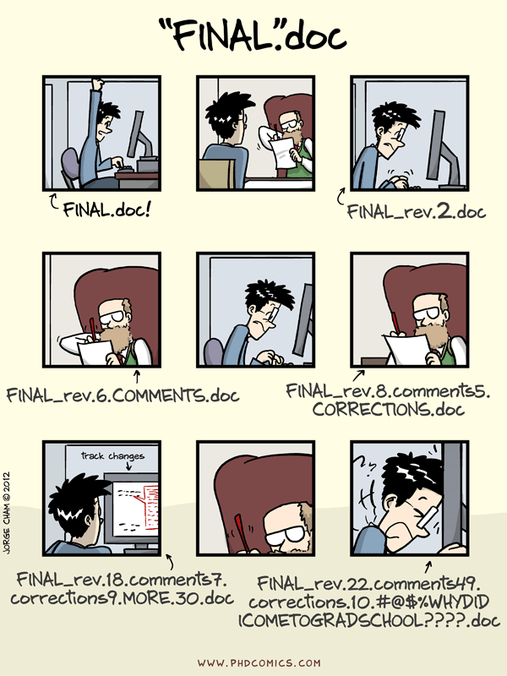
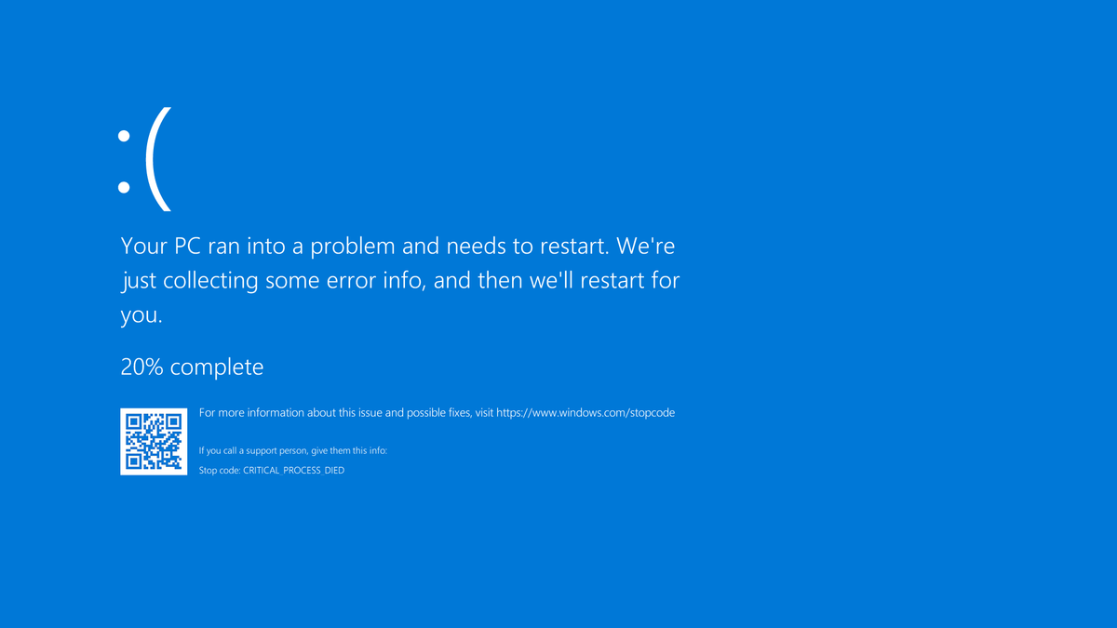





Why version control?
Source swcarpentry -> “Piled Higher and Deeper” by Jorge Cham, http://www.phdcomics.com

Slide 5
Task : Identify version control programs and instances.
E.g. MS Word Track Changes
Git
Google Docs
Revision Control systems
Concurrent Version Systems

Slide 6
Installing git on your computer
https://github.com/signup
Go to Apps Anywhere.
Launch git client.
Find git CMD through your search feature.
https://github.com/ryancrosbyr/SuttonTrust8-23

Slide 7
Git

Slide 8
Terminology
File / Directory
Repository
Staging Area
Add
Commit
Push
Pull
Branch
Fork

Slide 9
Repositories

Slide 10

Git Repositories
Local Repo
Remote Repo
A git repository tracks and saves different versions of your work. The repository tracks all of the changes made to the project during its lifetime.

Slide 11
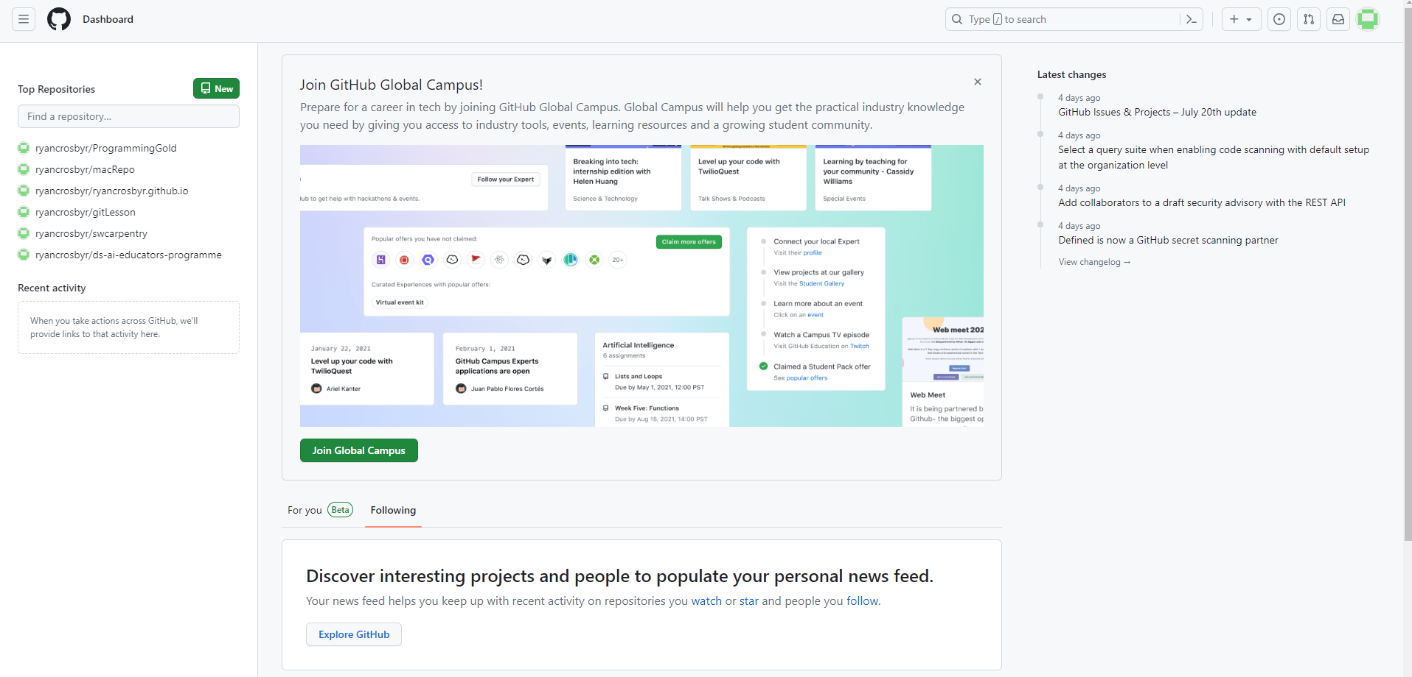
Creating a git repository
Within GitHub create a new repository

Slide 12
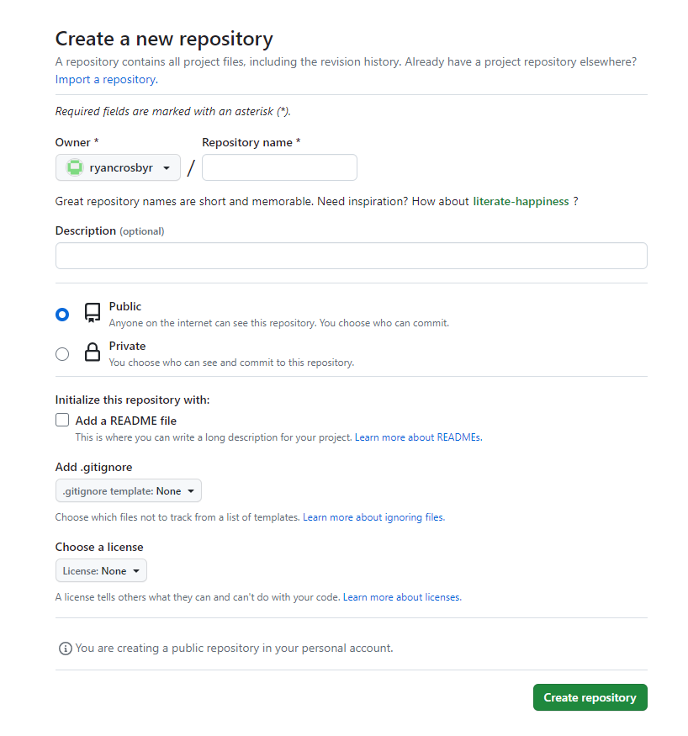
Creating a git repository

Slide 13
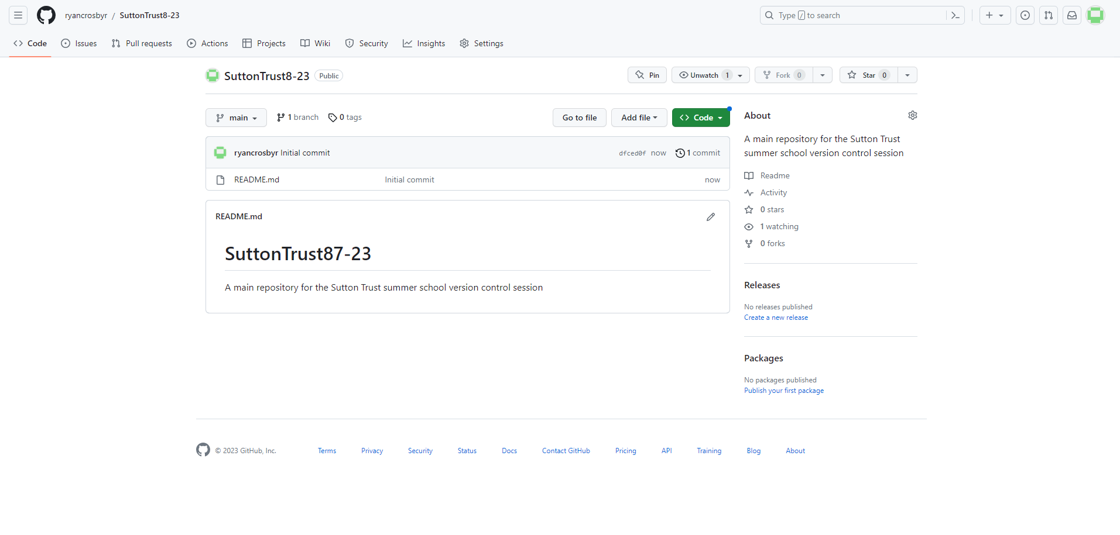
Creating a git repository
Within GitHub create a new repository

Slide 14
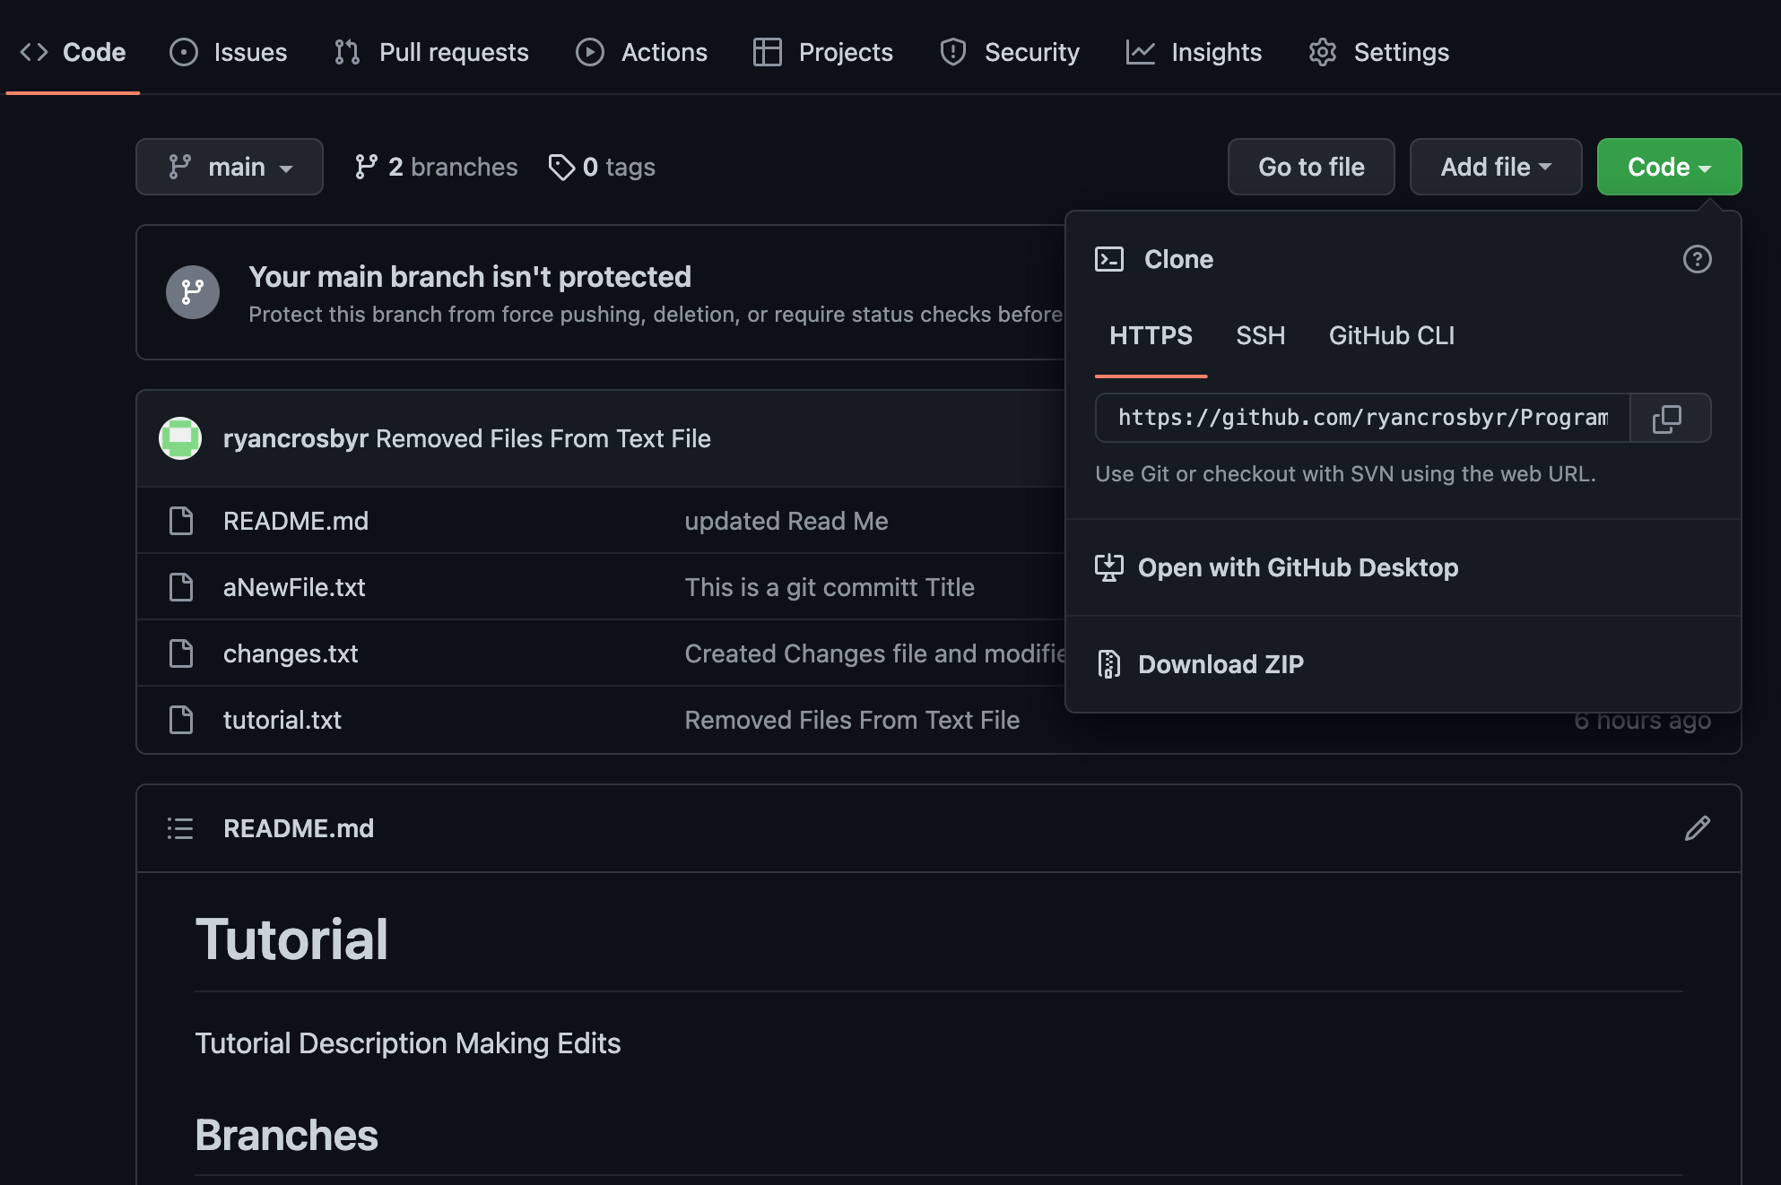
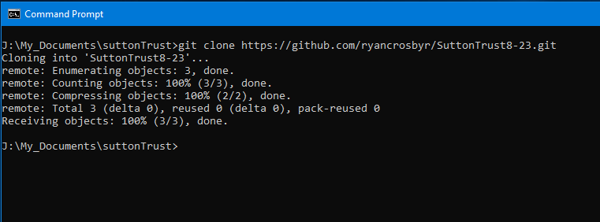
Connecting Remotely – Git Clone
If you do not have a local repository, however there is one remotely, a repository can be cloned from the git hub client, select the link provided by git hub and use the command:
git clone <link to repository>
Notes:
HTTPS gives read access
SSH gives edit access
git push -u origin main – tells git to always push to the remote repository that is defined as origin, so you don’t have to keep specifying

Slide 15
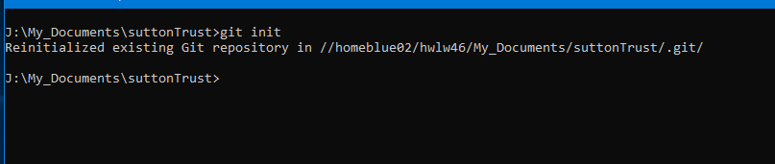
Turning an directory into a repository
From within the file system that you wish to turn into a remote repository
git init
Notes:
This then sets up the local directory with the information you need it to be a git repository. To check if your directory is a git repository look for a hidden .git file. Without this, the directory is not a repository. Can be done in the bash terminal with ls –a. or in windows command with dir /a:h

Slide 16
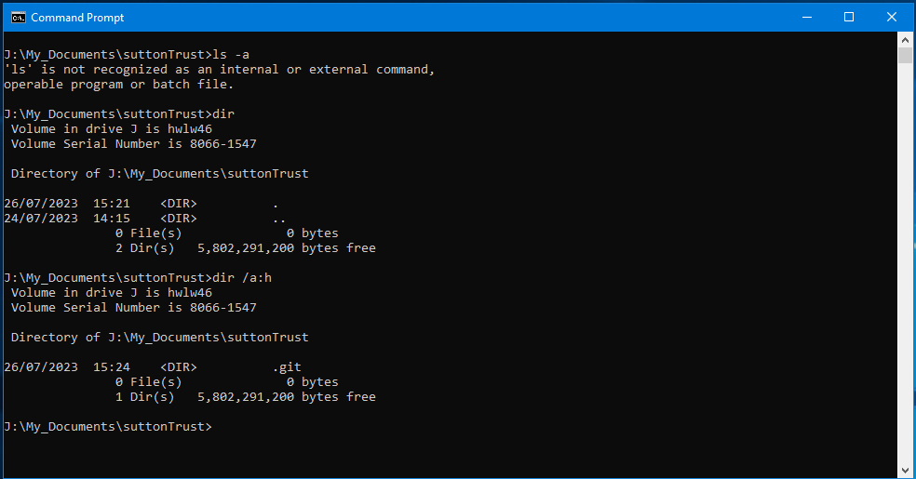
Turning an directory into a repository
How to check if your folder is a git repository.
Notes:
This then sets up the local directory with the information you need it to be a git repository. To check if your directory is a git repository look for a hidden .git file. Without this, the directory is not a repository. Can be done in the bash terminal with ls –a. dir /a:h

Slide 17
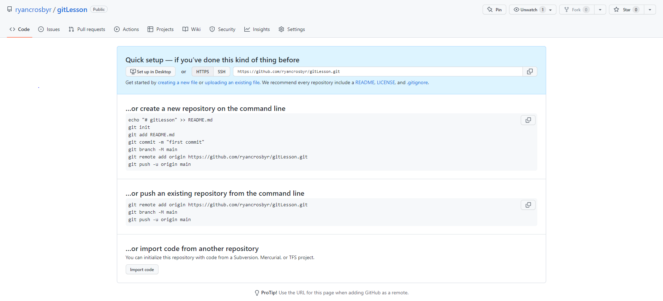
Connecting Remotely - Add origin
If you have a local repository (git init in file systems) already created you have to add the remote connection to that repository, rather than cloning the ‘online’ version
git remote add origin <URL>
Origin: Origin is essentially a keyword. Origin is the pointer which goes back to the remote repository – You can call this whatever you like, however as git calls cloned repositories origin you may as well stick to this convention.
Notes:
git push -u origin main – tells git to always push to the remote repository that is defined as origin, so you don’t have to keep specifying

Slide 18
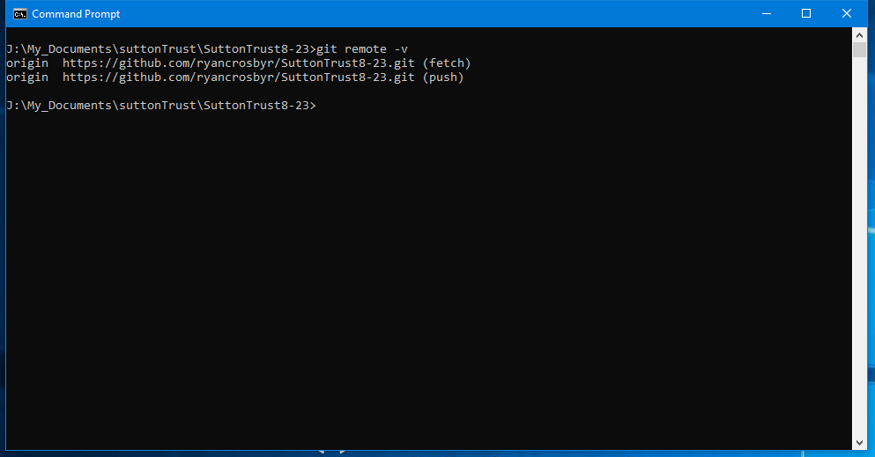
Git remote – v
Notes:
Remote –v allows you to check what connections you have. As you can see it is telling you where your connections are going to. Fetch is where you will get information from, and push is where you will send information too.

Slide 19
Git Procedures

Slide 20

Git General Flow
Local Repo
Remote Repo
Staging Area
Changes are made
Git add
Git commit
Git push
Git pull
Notes:
Now we have set up the git repositories the general flow is as follows

Slide 21
Git Status
Git status tells you what information git is aware of. If a file is untracked git has no knowledge that the file exists. Git will be able to tell you if one of the files in git has been changed or added too.
git status
Notes:
To understand what git is aware of – we use git status. Git status will tell us if a file has had changes to it that git is unaware of. If it has changes that it is aware of, or if nothing needs to happen.

Slide 22
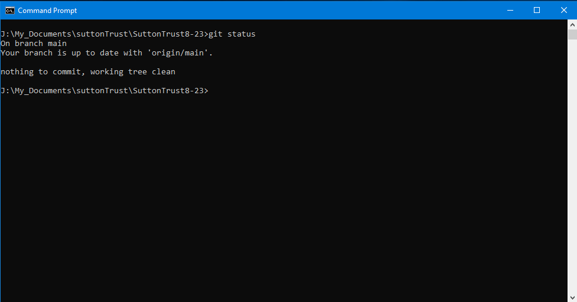
A clean working tree
Notes:
A clean working tree means that the branch (discussed later) has no changes or commits needed.

Slide 23
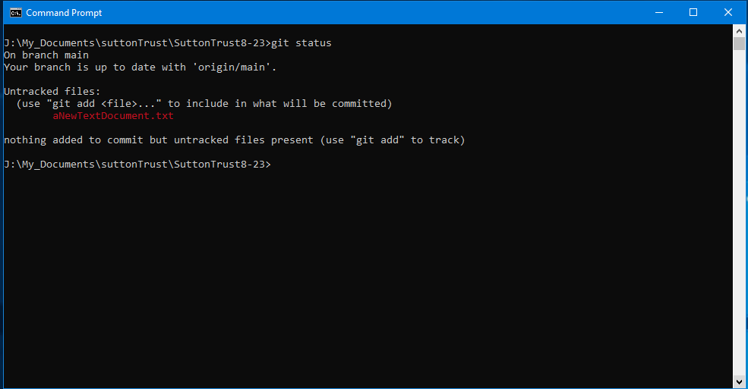
Changes in files / new files
Notes:
If a file is red or untracked, this means that you have made changes to the file (or created a new file) that you need to tell git about. We do this using the command git add.

Slide 24
Git Add
If you have an untracked file or a file with changes you need to add it to the git stating area:
git add filename.txt
git add .

Slide 25
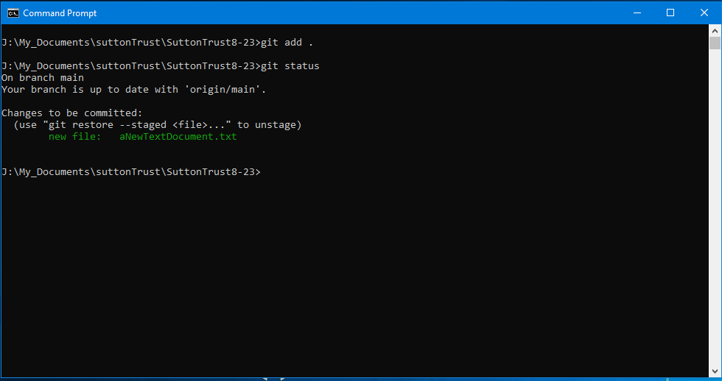
Back to git status
Notes:
This will now tell us that git is aware of changes made to the files. However, this has not been added into the staging area. So as far as git is aware nothing has been changed.

Slide 26
Git Commit
After you have added your files to the staging area you need to commit them. Think of this as saying to git “Yes I am ready for these changes to go onto the branch I am committing to it”. P.s this doesn’t mean you cannot change your mind.
The command to run a git commit in the terminal is as follows
git commit -m “Title” -m “Description”
-m is an instruction that a message will follow. If there are two -m the order
is the title of the commit and the description. If there is only one, this only
uploads a title.
Notes:
When you do a git commit you should always give a good message and description regarding what changes you have made. This is not just for other people who may look at your code, but for future you. It doesn’t matter how much you think your code makes sense to you now, in 6+ months when you look at it again some parts of it will be confusing. A commit message has a title and a description. In Git Hub this looks like the figure below.
Each git commit should only have one change. After each change commit your files. This allows for an efficient version control.

Slide 27
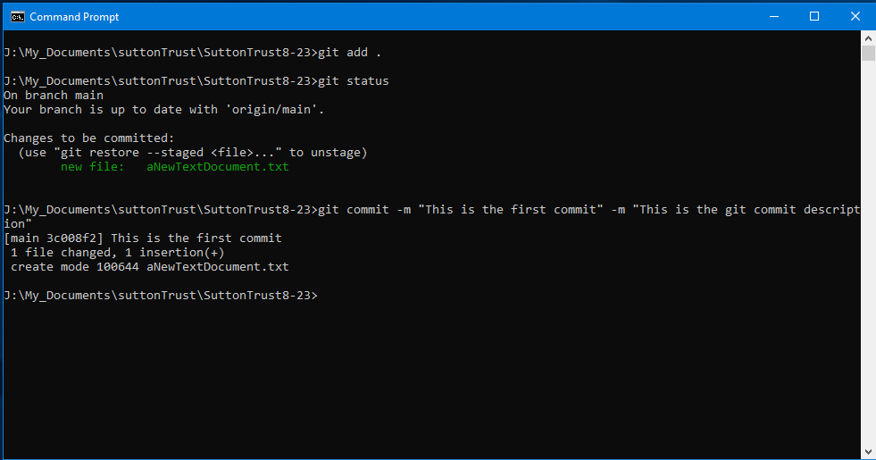
Git Commit
Notes:
This has now put the changes into the git staging area – how do we view the staging area?

Slide 28
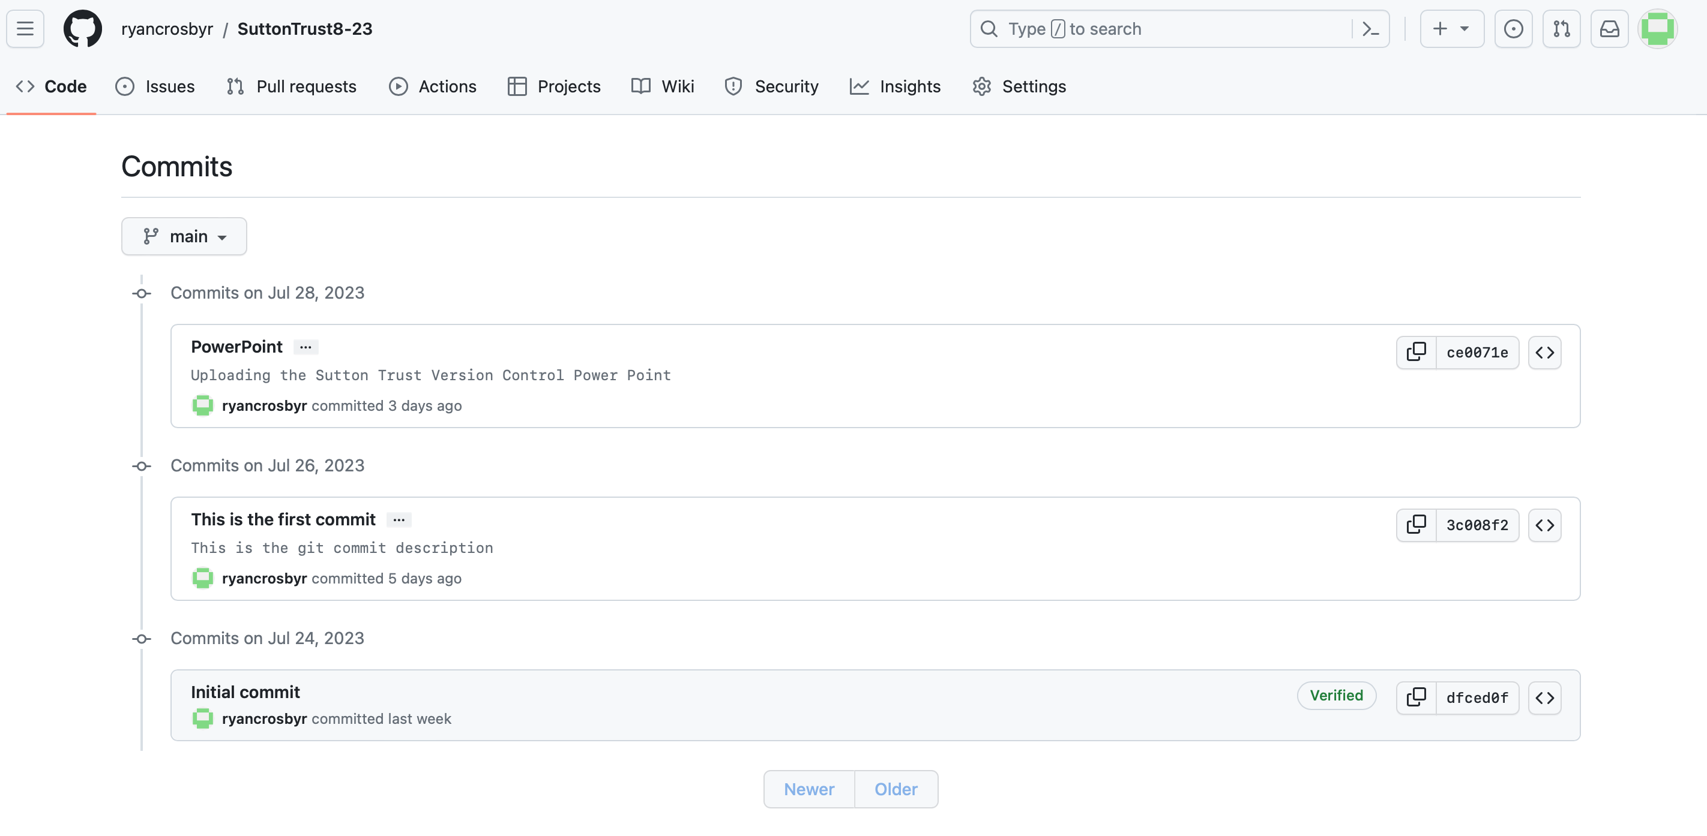

Slide 29
Git Push
A push sends all committed changes from your local repository to the remote repository
git push <remote repository name> <remote branch name>
Notes:
When you push you need to tell git what to push too – the command on screen tells git to push the main branch you are working on to the remote repository ‘origin’
Git push ‘publishes’ the local changes to the remote repository.
You set the upstream to be the branch you are working on at that given time.
---- additional info ----
Let us briefly look at a feature called branches (we will get to more descriptions of this later). When you want to push, you have to inform git where you wish to push too and which branch on that repository. As you can see main has a destination already specified (in the blue, we have already set the upstream). Therefore you will only ever need to type ‘git push’ when in the main. For feature-001 there is currently no destination. We have two options here, we can either tell git where we want the pushes to go every time we push, or we can set an upstream.

Slide 30
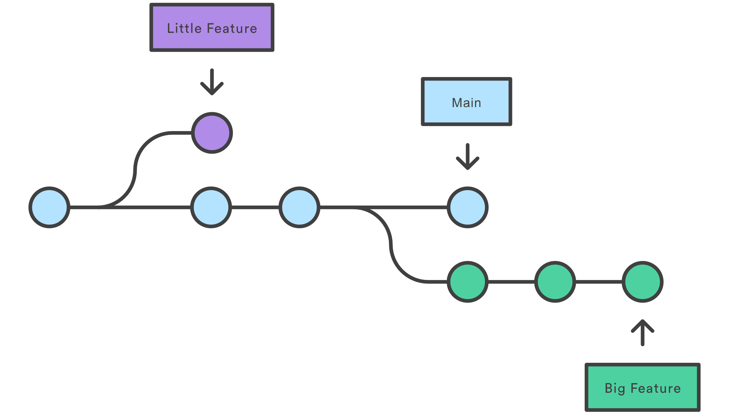
Branching
Branching is a feature of git which allows you to create a ‘sandbox’ of the code.
Source: https://www.atlassian.com/git/tutorials/what-is-version-control
Notes:
You typically branch in git to allow yourself an area to modify codes / develop features / fix bugs. Whenever you work in git you want to avoid working on the main. Branch –vv
Git checkout –b branchName
Git checkout branchname
Git branch a – list all remote branches

Slide 31
Branching
gitLesson
Feature 1 Branch
Feature 2 Branch

Slide 32
Viewing Branches
Git branch –vv
Git branch -a
Notes:
Branch –vv shows all the branches you have (locally), the upstream in the branches and the last git commit title
Branch –a shows all the branches remotely

Slide 33
Creating Branches
Git branch branchName
Git branch
Git checkout –b branchName
Git checkout branchname
What is the difference between these commands?
Notes:
Git branch branchName (Creates a new branch)
Git branch –a list all branches
Git checkout –b branchName (Create a new branch and switch to it.)
Git checkout branchname (Switch to a branch)

Slide 34
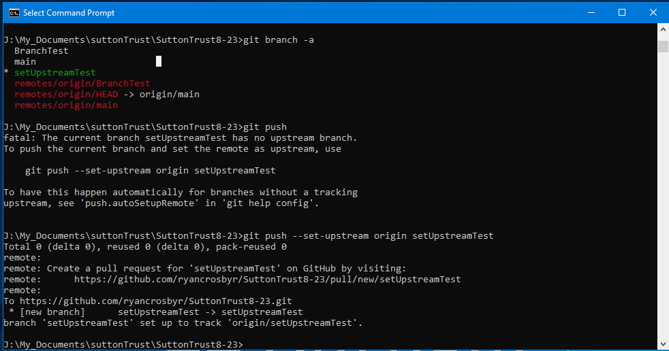

Slide 35
Task: Create a story using git branches
Setup:
Create a new git repository remotely and locally, then connect them.
Create the Main Story:
Create a new file named story.txt and write the beginning of a story.
Save and commit the story.
Create a Branch for each chapter / section ( have at least three):
Develop each section
Review the different Storylines (using checkout):
Push everything together.
Clone a friends story

Slide 36
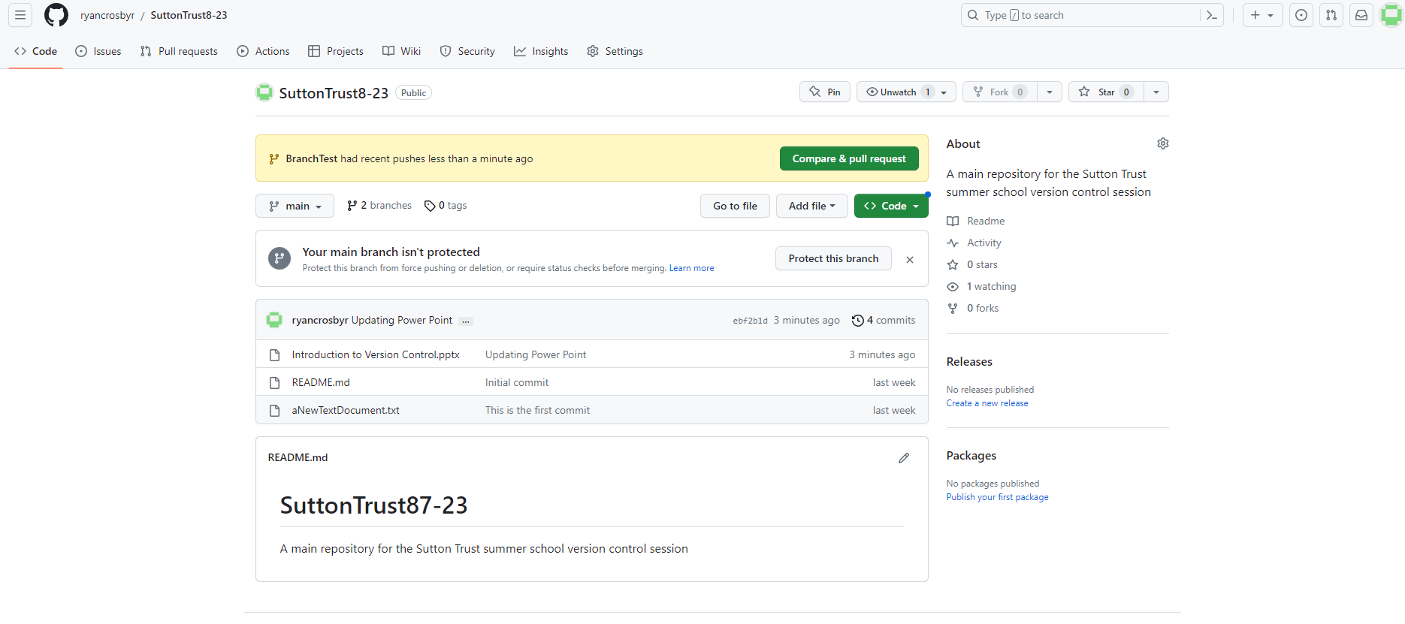

Slide 37
Git pull
Git pull will bring changes that have been made to a repository into your machine. (Or Vice Versa)
It is a joint command of fetch and merge. It synchronises your local repository with the remote one.
When pulling on the main: pull requests are a signal that the developer is finished working on that branch and wishes to integrate it with the main branch.
Notes:
Git pull requests ‘pull changes into the main branch – they merge together.’ The should be used to ensure code quality and good practice. This helps reduce the risk of system crashing changes.
git fetch which downloads content from the specified remote repository.
hen a git merge is executed to merge the remote content refs and heads into a new local merge commit
git fetch will download the remote content and not alter the state of the local repository
This means that you need to provide 4 pieces of information to file a pull request: the source repository, the source branch, the destination repository, and the destination branch. When working on feature branch, when wanting to merge into the main to say you have finished development of the feature the source will be your feature branch, and the destination will be the main branch. Pul

Slide 38
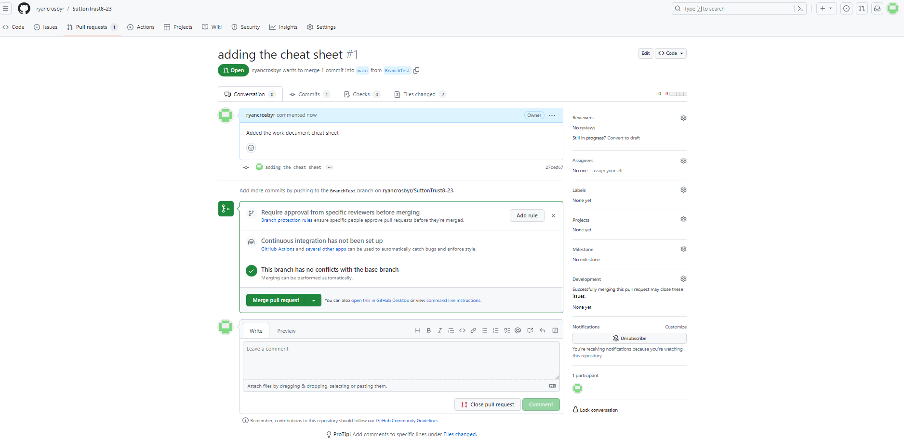
Git pull

Slide 39
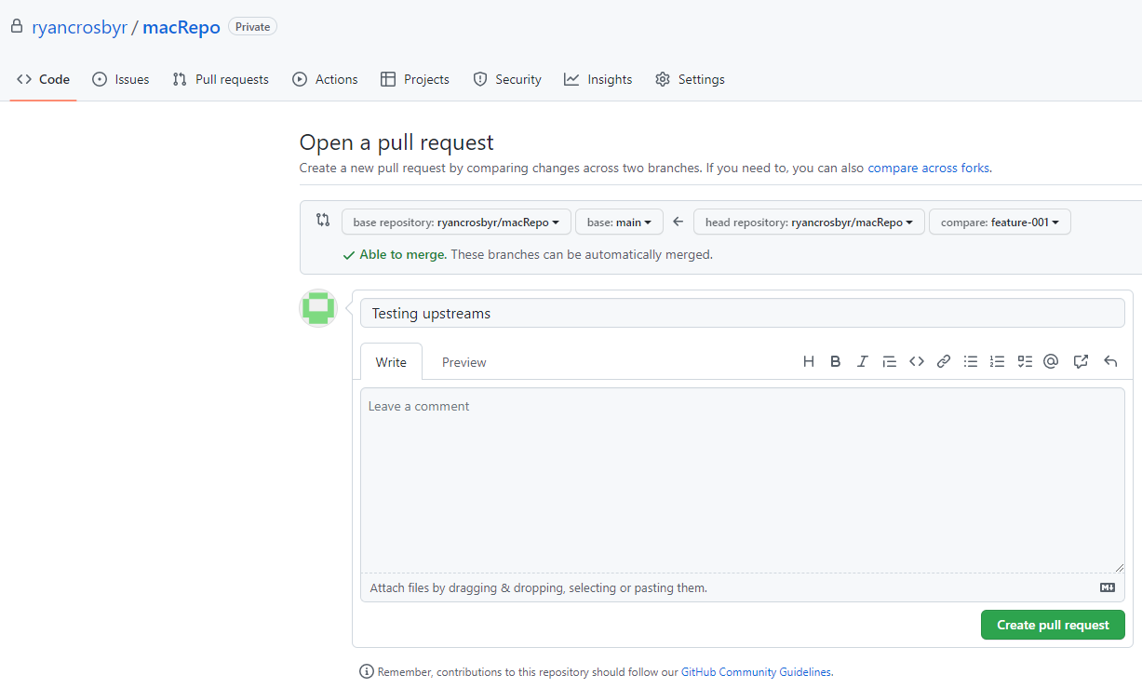
Open a pull request
Notes:
Would you like to pull and merge the new files in feature-001 into main?

Slide 40
Forking
Forking takes a copy of everything in the repository and creates your own version of it.
gitLesson
gitLesson
studentGitLesson
Fork
Student 1 Branch
Student 2 Branch
Your Branch
Your Branch
Notes:
Forking (which is what we do with git clone (shown ealier) makes a copy of the repository you are working on.

Slide 41
Finished everything? Try this….
Research specifying git pull
Research git merging
Git tutorial: https://tinyurl.com/bdcsckhz

